Slide 1
Recovering metric and affine properties from images
Affine preserves:
Parallelism
Parallel length ratios
Similarity preserves:
Angles
Length ratios
Will show:
Projective distortion can be removed once image of line at
infinity is specified
Affine distortion removed once image of circular points is specified
Then the remaining distortion is only similarity

Slide 2
The line at infinity
For an affine transformation line at infinity maps onto line at infinity
The line at infinity l∞ is a fixed line under a projective transformation H if and only if H is an affinity
A point on line at infinity is mapped to ANOTHER point on the line at infinity, not
necessarily the same point
Note: not fixed pointwise

Slide 3
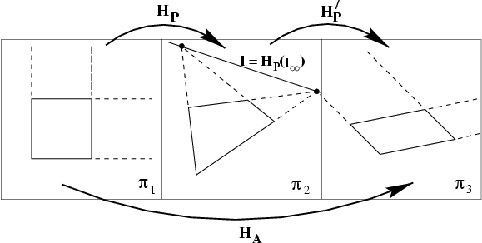
Affine properties from images
projection
rectification
Euclidean plane
Two step process:
1.Find l the image of line
at infinity in plane 2
2. Transform l to its
canonical position
(0,0,1) ^{T} by plugging into
H_{PA} and applying it to
the entire image to get a
“rectified” image
3. Make affine measurements
on the rectified image

Slide 4
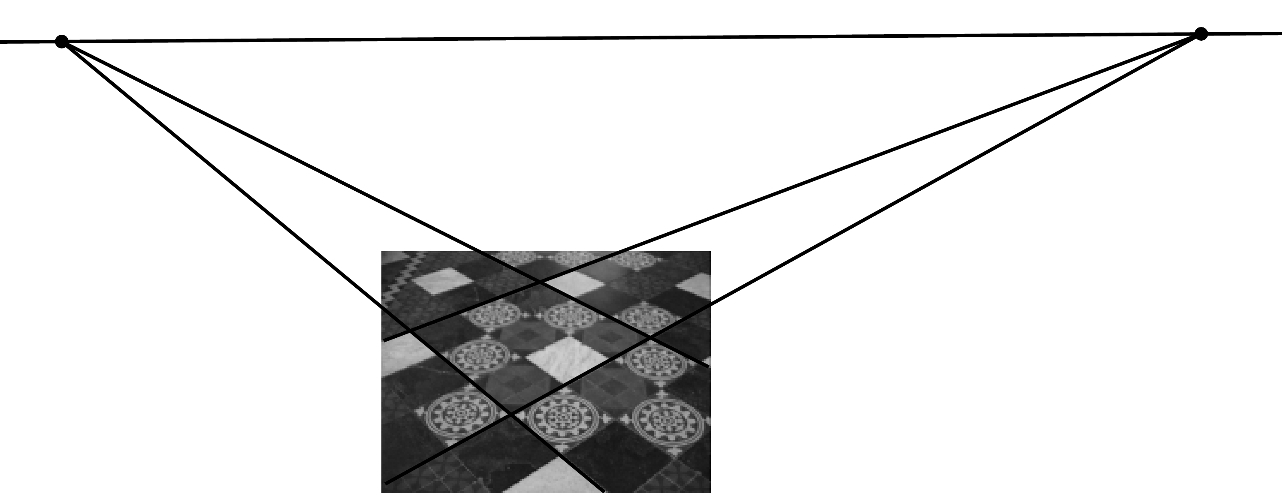
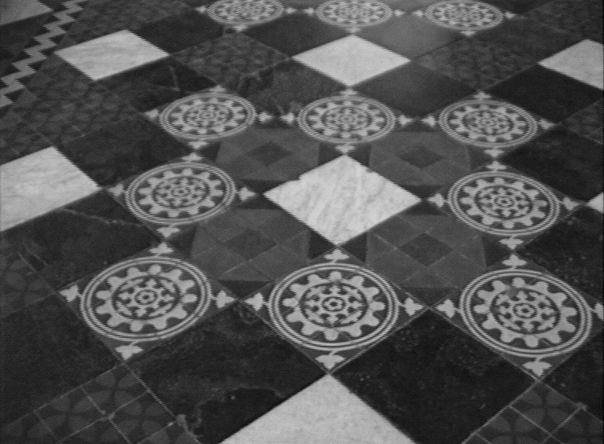
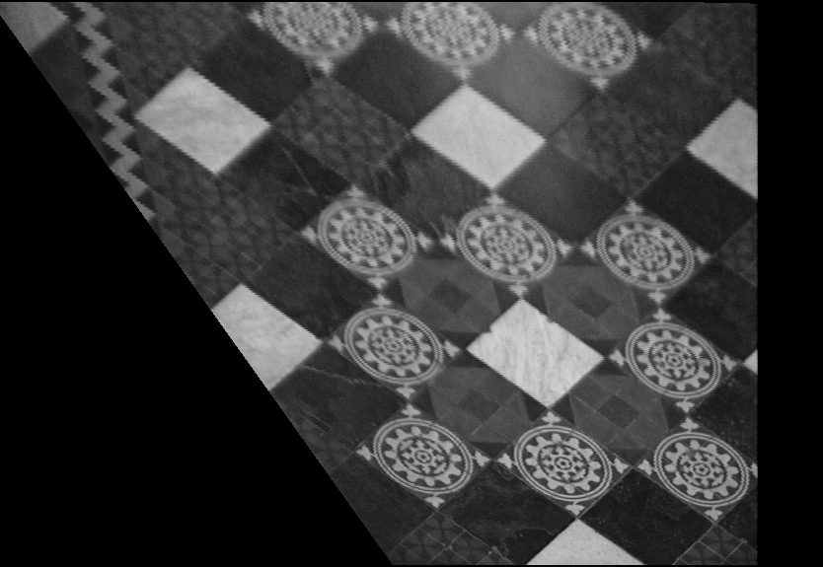
Affine rectification
v₁
l∞
v₂
l₁
l₃
l₂
l₄
c
a b

Slide 5
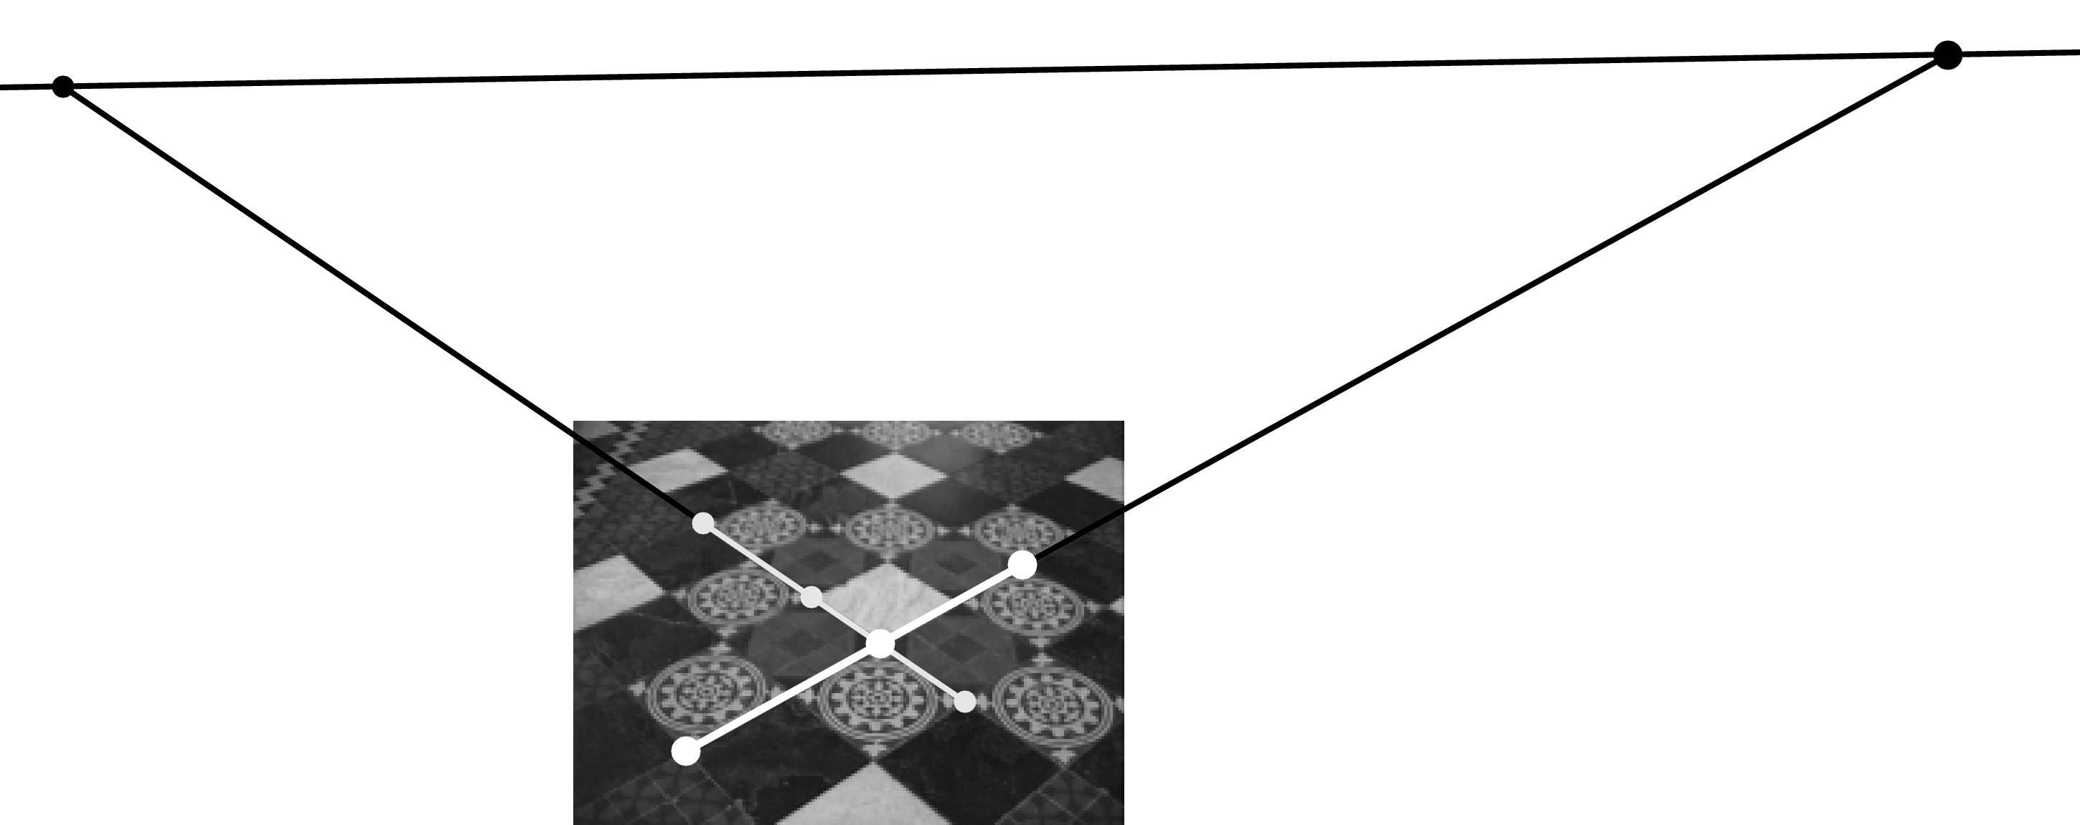
Distance ratios

Slide 6
The circular points
Two points on l_inf: Every circle intersects l_inf at circular points
“circular points”
l∞
Circle:
Line at infinity

Slide 7
The circular points
Circular points are fixed under any similarity transformation
Canonical coordinates
of circular points
The circular points I, J are fixed points under the projective transformation H iff H is a similarity
Identifying circular points allows recovery of similarity properties i.e. angles
ratios of lengths

Slide 8
Conic dual to the circular points
The dual conic is fixed conic under the
projective transformation H iff H is a similarity
Note: has 4DOF (3x3 homogeneous; symmetric, determinant is zero)
l∞ is the nullvector

Slide 9
Angles
Euclidean Geometry: not invariant under
projective transformation
Projective:
The above equation is invariant under projective transformation ➔ can be applied
after projective transformation of the plane.
(orthogonal)
Once is identified in the projective plane, then Euclidean angles
may be measured by equation (1)

Slide 10
Length ratios

Slide 11
Metric properties from images
Upshot: projective (v) and affine (K) components directly determined from the image
of C*∞
Once C*∞ is identified on the projective plane then projective distortion may be
rectified up to a similarity
Can show that the rectifying transformation is obtained by applying SVD to
Apply U to the pixels in the projective plane to rectify the image up to a Similarity

Slide 12
SVD Decompose to get U
Recovering up to a similarity from Projective
Perspective
transformation
Rectifying
Transformation: U
C*∞
Rectified image
Euclidean
Projectively
Distorted
Image
Similarity transformation

Slide 13
Recovering up to a similarity from Affine
affine
transformation
Rectifying
Transformation: U
C*∞
Rectified image
Euclidean
Affinely
Distorted
Image
Similarity transformation

Slide 14
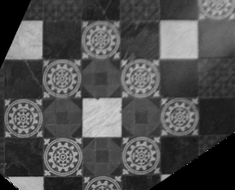
Metric from affine
Affine rectified

Slide 15
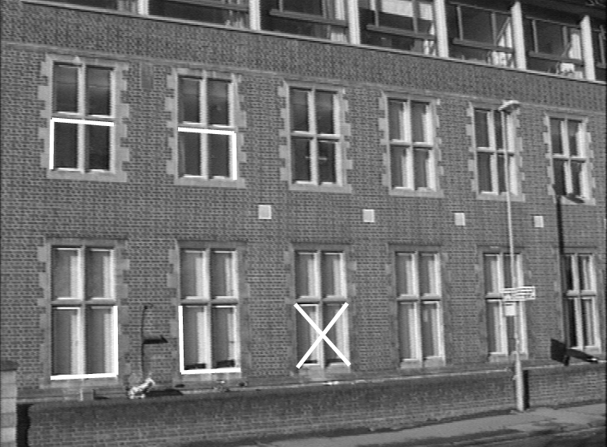
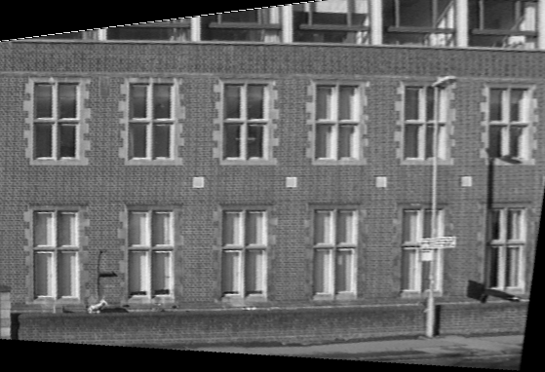
Metric from projective

Slide 16
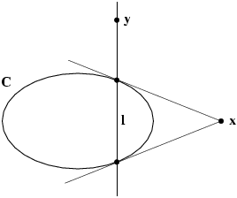
Pole-polar relationship
The polar line l=Cx of the point x with respect to the conic C intersects the conic in two points. The two lines tangent to C at these points intersect at x

Slide 17
Correlations and conjugate points
A correlation is an invertible mapping from points of P² to lines of P². It is represented by a 3x3 non-singular matrix A as l=Ax
Conjugate points with respect to C
(on each others polar)
Conjugate lines
with respect to C*
(through each others pole)

Slide 18
Projective conic classification
Diagonal | Equation | Conic type
(1,1,1) |  | improper conic
(1,1,-1) |  | circle
(1,1,0) |  | single real point
(1,-1,0) |  | two lines
(1,0,0) |  | single line

Slide 19
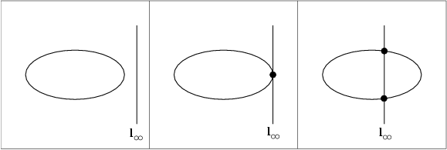
Affine conic classification
ellipse
parabola
hyperbola

Slide 20
Chasles’ theorem
Conic = locus of constant cross-ratio towards 4 ref. points
A
B
C
X
D

Slide 21
Iso-disparity curves
X_{i}
X_{j}
X₀
X₁
C₁
C₂
X∞

Slide 22
Fixed points and lines
(eigenvectors H =fixed points)
(λ₁=λ₂ ⇒ pointwise fixed line)
( eigenvectors H^{-T} =fixed lines)

Slide 23
Projective 3D geometry

Slide 24
Singular Value Decomposition

Slide 25
Singular Value Decomposition
Homogeneous least-squares
Span and null-space
Closest rank r approximation
Pseudo inverse

Slide 26
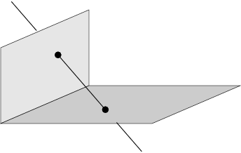
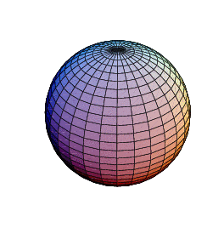
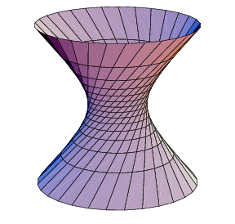
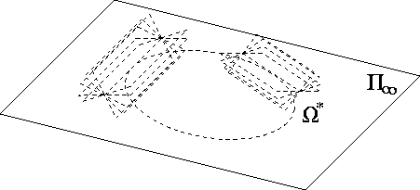
Projective 3D Geometry
Points, lines, planes and quadrics
Transformations
П∞, ω∞ and Ω ∞

Slide 27
3D points
3D point
in R³
in P³
projective transformation
(4x4-1=15 dof)

Slide 28
Planes
3D plane
Transformation
Euclidean representation
Dual: points ↔ planes, lines ↔ lines

Slide 29
Planes from points
(solve as right nullspace of )
Or implicitly from coplanarity condition

Slide 30
Points from planes
(solve as right nullspace of )
Representing a plane by its span
M is 4x3 matrix. Columns of M are null space of
X is a point on plane
x ( a point on projective plane P² ) parameterizes points on the plane π
M is not unique

Slide 31
Lines
Line is either joint of two points or intersection of two planes
Representing a line by its span: two vectors A, B for two space points
(4dof)
Span of W^{T} is the pencil
of points
on the line
Span of the 2D right
null space of W is the
pencil of the planes
with the line as axis
2x4
Span of W^{*T} is the pencil of
Planes with the
line as axis
Dual representation: P and Q are planes; line is span of row space of W*
2x4
Example: X-axis:
join of (0,0,0) and (1,0,0) points Intersection of y=0 and z=0
planes

Slide 32
Points, lines and planes
Plane π defined by the join of the point X and line W is
obtained from the null space of M:
Point X defined by the intersection of line W with
plane is the null space of M

Slide 33
Plücker matrices
Plücker matrix (4x4 skew-symmetric homogeneous matrix)
L has rank 2
4dof
generalization of
L independent of choice A and B
Transformation
Example: x-axis
Notes:
A,B on line AW*=0, BW*=0, …
4dof, skew symmetric 6dof, scale -1, rank2 -1
Prove independence of choice by filling in C=A+muB, AA-AA disappears, …
Prove transform based on A’=HA, B’=HB,…

Slide 34
Plücker matrices
Dual Plücker matrix L*
Correspondence
Join and incidence
(plane through point and line)
(point on line)
(intersection point of plane and line)
(line in plane)
(coplanar lines)
Notes:
Indicate 12-34 {1234} always present
Prove join (AB’+BA’)P=A (if A’P=0) which is general since L independent of A and B
Example intersection X-axis with X=1: X=counterdiag(-1 0 0 1)(1 0 0 -1)’=(1 0 0 1)’

Slide 35
Plücker line coordinates
on Klein quadric
Notes:
L consists of non-zero elements

Slide 36
Plücker line coordinates
(Plücker internal constraint)
(two lines intersect)
(two lines intersect)
(two lines intersect)

Slide 37
Quadrics and dual quadrics
Quadratic surface in P³ defined by:
(Q : 4x4 symmetric matrix)
9 d.o.f.
in general 9 points define quadric
det Q=0 ↔ degenerate quadric
(plane ∩ quadric)=conic
transformation
Dual Quadric: defines equation on planes: tangent planes π to
the point quadric Q satisfy:
relation to quadric (non-degenerate)
transformation
Notes:
3. and thus defined by less points
4. On quadric=> tangent, outside quadric=> plane through tangent point
5. Derive X’QX=x’M’QMx=0

Slide 38
Quadric classification
Rank | Sign. | Diagonal | Equation | Realization
4 | 4 | (1,1,1,1) | X²+ Y²+ Z²+1=0 | No real points
 | 2 | (1,1,1,-1) | X²+ Y²+ Z²=1 | Sphere
 | 0 | (1,1,-1,-1) | X²+ Y²= Z²+1 | Hyperboloid (1S)
3 | 3 | (1,1,1,0) | X²+ Y²+ Z²=0 | Single point
 | 1 | (1,1,-1,0) | X²+ Y²= Z² | Cone
2 | 2 | (1,1,0,0) | X²+ Y²= 0 | Single line
 | 0 | (1,-1,0,0) | X²= Y² | Two planes
1 | 1 | (1,0,0,0) | X²=0 | Single plane
Notes:
Signature sigma= sum of diagonal,e.g. +1+1+1-1=2,always more + than -, so always positive…

Slide 39
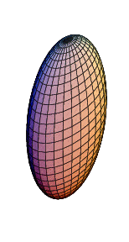
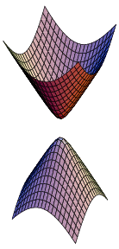
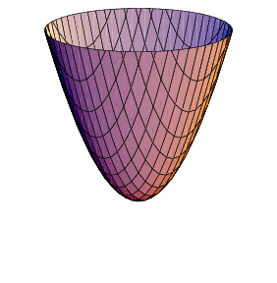
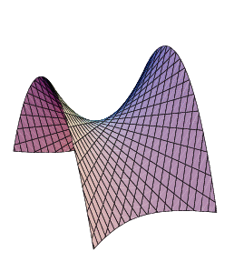
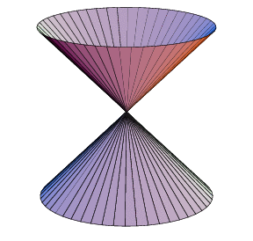
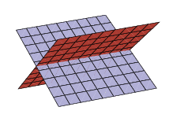
Quadric classification
Projectively equivalent to sphere:
sphere
ellipsoid
hyperboloid of two sheets
paraboloid
Ruled quadrics:
hyperboloids of one sheet
Degenerate ruled quadrics:
cone
two planes
Notes:
Ruled quadric: two family of lines, called generators.
Hyperboloid of 1 sheet topologically equivalent to torus!

Slide 40
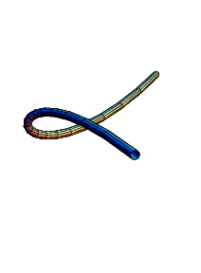
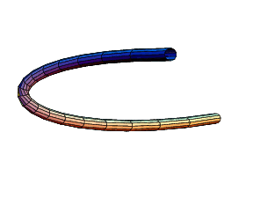
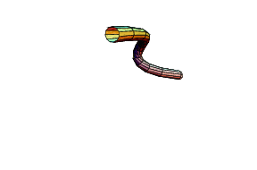
Twisted cubic
twisted cubic
conic
3 intersection with plane (in general)
12 dof (15 for A – 3 for reparametrisation (1 θ θ²θ³)
2 constraints per point on cubic, defined by 6 points
projectively equivalent to (1 θ θ²θ³)
Horopter & degenerate case for reconstruction

Slide 41
Hierarchy of transformations
group transform distortion invariants properties
Projective
15dof
Intersection and tangency
Parallellism of planes,
Volume ratios, centroids,
The plane at infinity π∞
Affine
12dof
Similarity
7dof
The absolute conic Ω∞
Euclidean
6dof
Volume

Slide 42
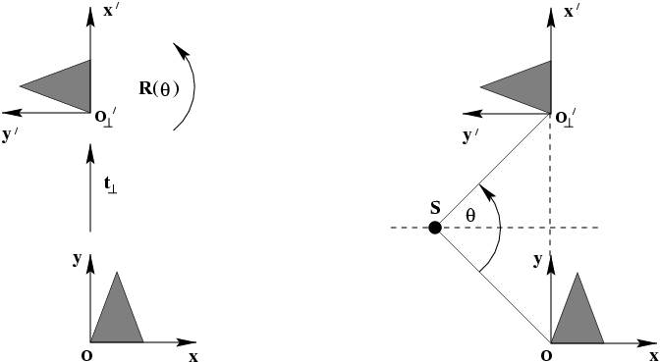
Screw decomposition
Any particular translation and rotation is equivalent to a rotation about a screw axis and a translation along the screw axis.

Slide 43
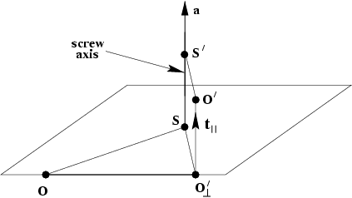
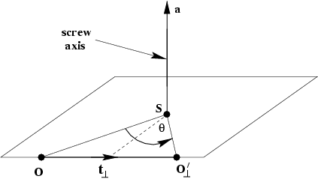
2D Euclidean Motion and the screw decomposition
screw axis // rotation axis

Slide 44
The plane at infinity
The plane at infinity π∞ is a fixed plane under a projective transformation H iff H is an affinity
canonical position
contains directions
two planes are parallel ⇔ line of intersection in π∞
line // line (or plane) ⇔ point of intersection in π∞
Notes:
Represents 3DOF between projective and affine

Slide 45
The absolute conic
The absolute conic Ω∞ is a (point) conic on π∞.
In a metric frame:
The absolute conic Ω∞ is a fixed conic under the projective transformation H iff H is a similarity
Ω∞ is only fixed as a set, not pointwise
Circle intersect Ω∞ in two points
All Spheres intersect π∞ in Ω∞
Notes:
Represent 5 DOF between affine and similarity

Slide 46
The absolute conic
Euclidean:
Projective:
(orthogonality=conjugacy)
d1 and d2 are lines
Notes:
Orthogonality is conjugacy with respect to Absolute Conic

Slide 47
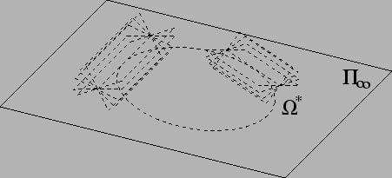
The absolute dual quadric
Absolute dual Quadric = All planes tangent to Ω∞
The absolute conic Q*∞ is a fixed conic under the projective transformation H iff H is a similarity
8 dof
plane at infinity π∞ is the nullvector of
Angles:

